Slide 1

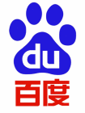




Comparison of Google and Baidu
thezmmm Time：2022.05

Slide 2
PART 01
Search result
Contents
PART 02
Advertisement
PART 03
Market
PART 04
Convenience

Slide 3

Search Result
01

Slide 4
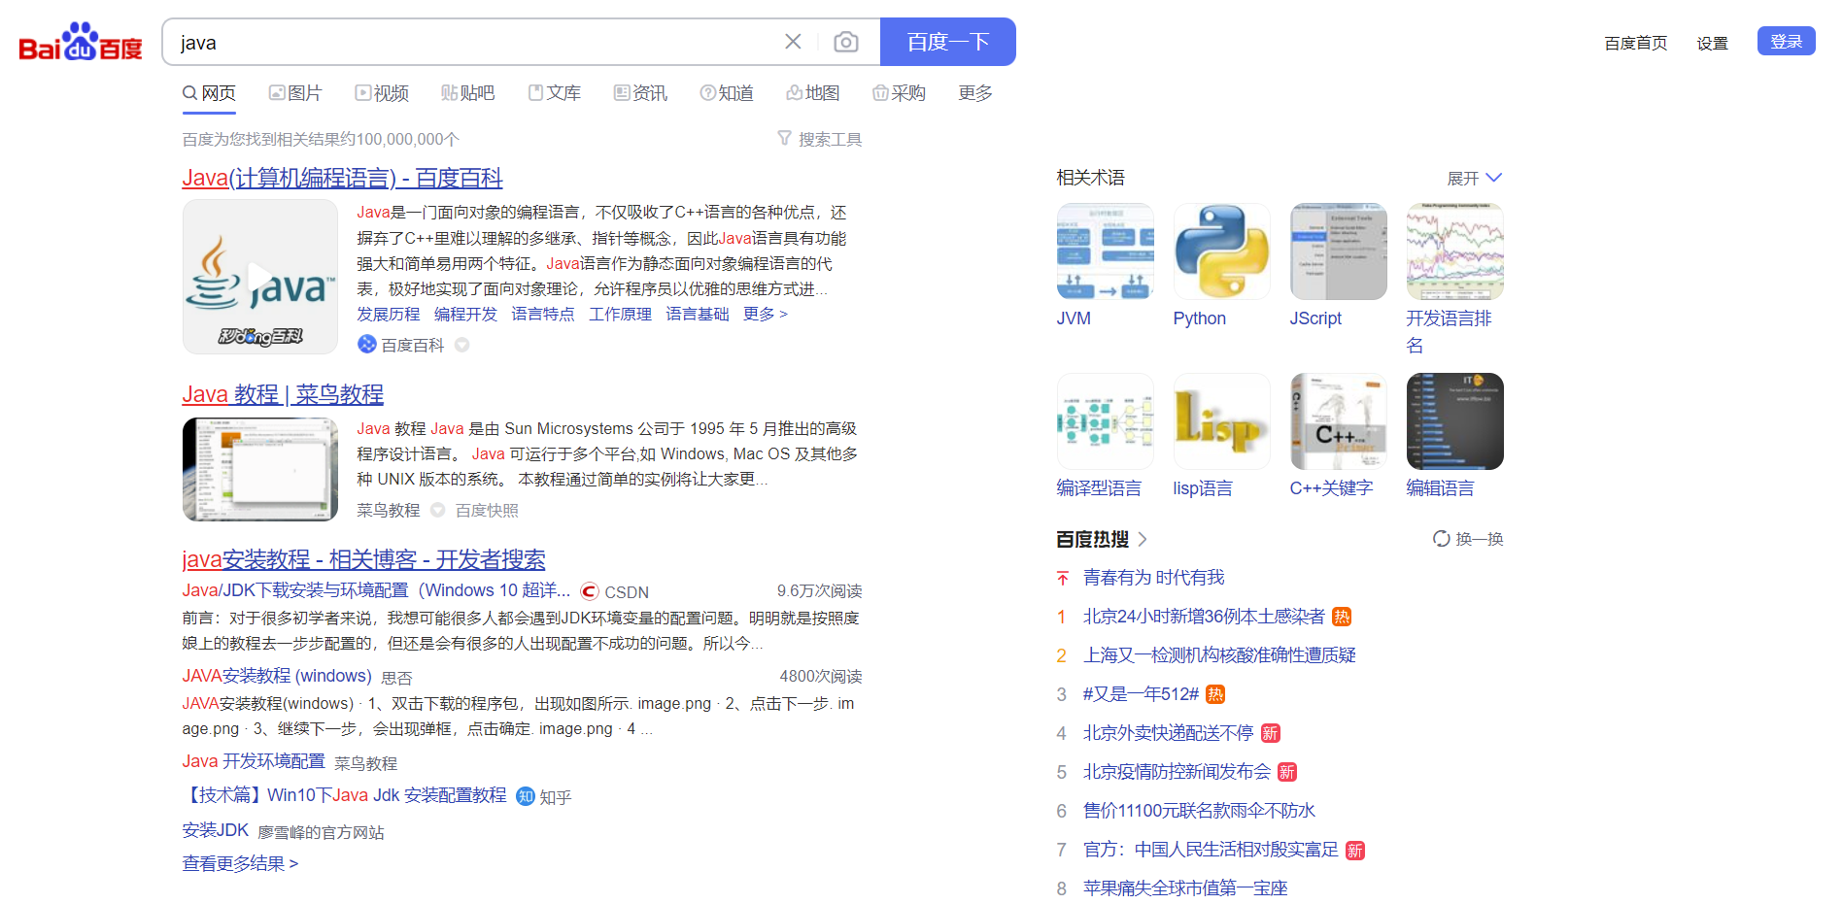
The result in Baidu
输入您的标题
OUR COMPANY
Your content to play here, or through paste in this box, and select only the text. Your content to play here
first, search "java" in Baidu , and you will find that nothing is useful in the right. Even the content
in the lower right corner has nothing to do with the search content

Slide 5
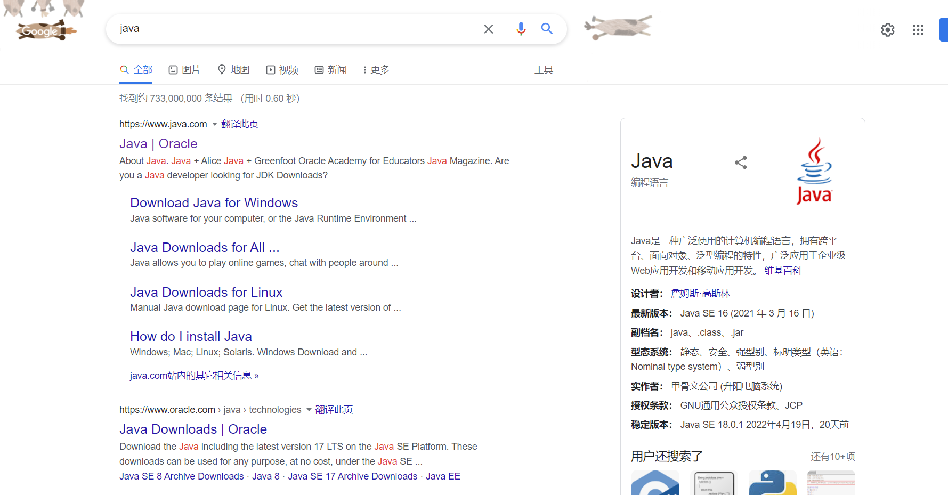
The result in Google
输入您的标题
OUR COMPANY
Your content to play here, or through paste in this box, and select only the text. Your content to play here
And then search the same content in google, you will find nothing useless, and At the top is the java official website. You can’t get it when you search “java” in Baidu unless you search “official java website”.

Slide 6
Advertisement
02

Slide 7
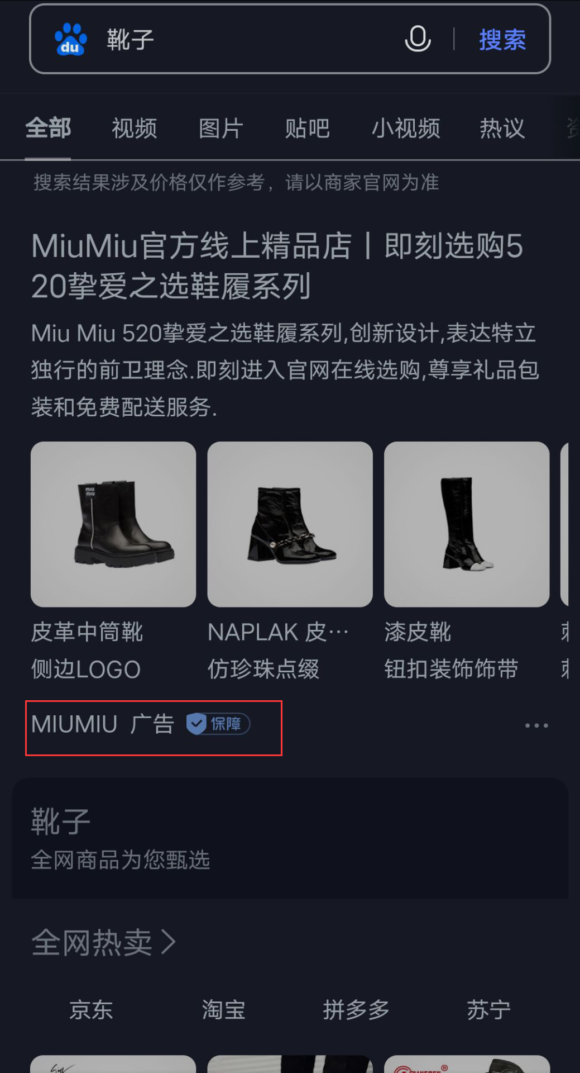
Advertisement in Baidu
If you search for something you can find on Taobao and You will get an ad at the top.
The situation is the same in both
But there are some differences in the details

Slide 8

Ad details
Baidu gives high priority to some fake websites.
Baidu should bear some responsibility for some fraudulent acts
Reason
Google made a detailed statement for the ads and established standards for advertising.
These you can’t find in Baidu.
Cheat

Slide 9
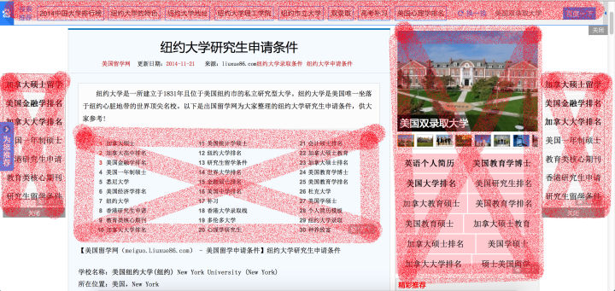
Double advertising
输入您的标题
OUR COMPANY
Your content to play here, or through paste in this box, and select only the text. Your content to play here
I don't care advertisement in search result , but I'm really mindful of the ads inside the pages. When you open a web page, 80% of the content of the page is advertised. This is a huge waste of time

Slide 10
Market
03

Slide 11
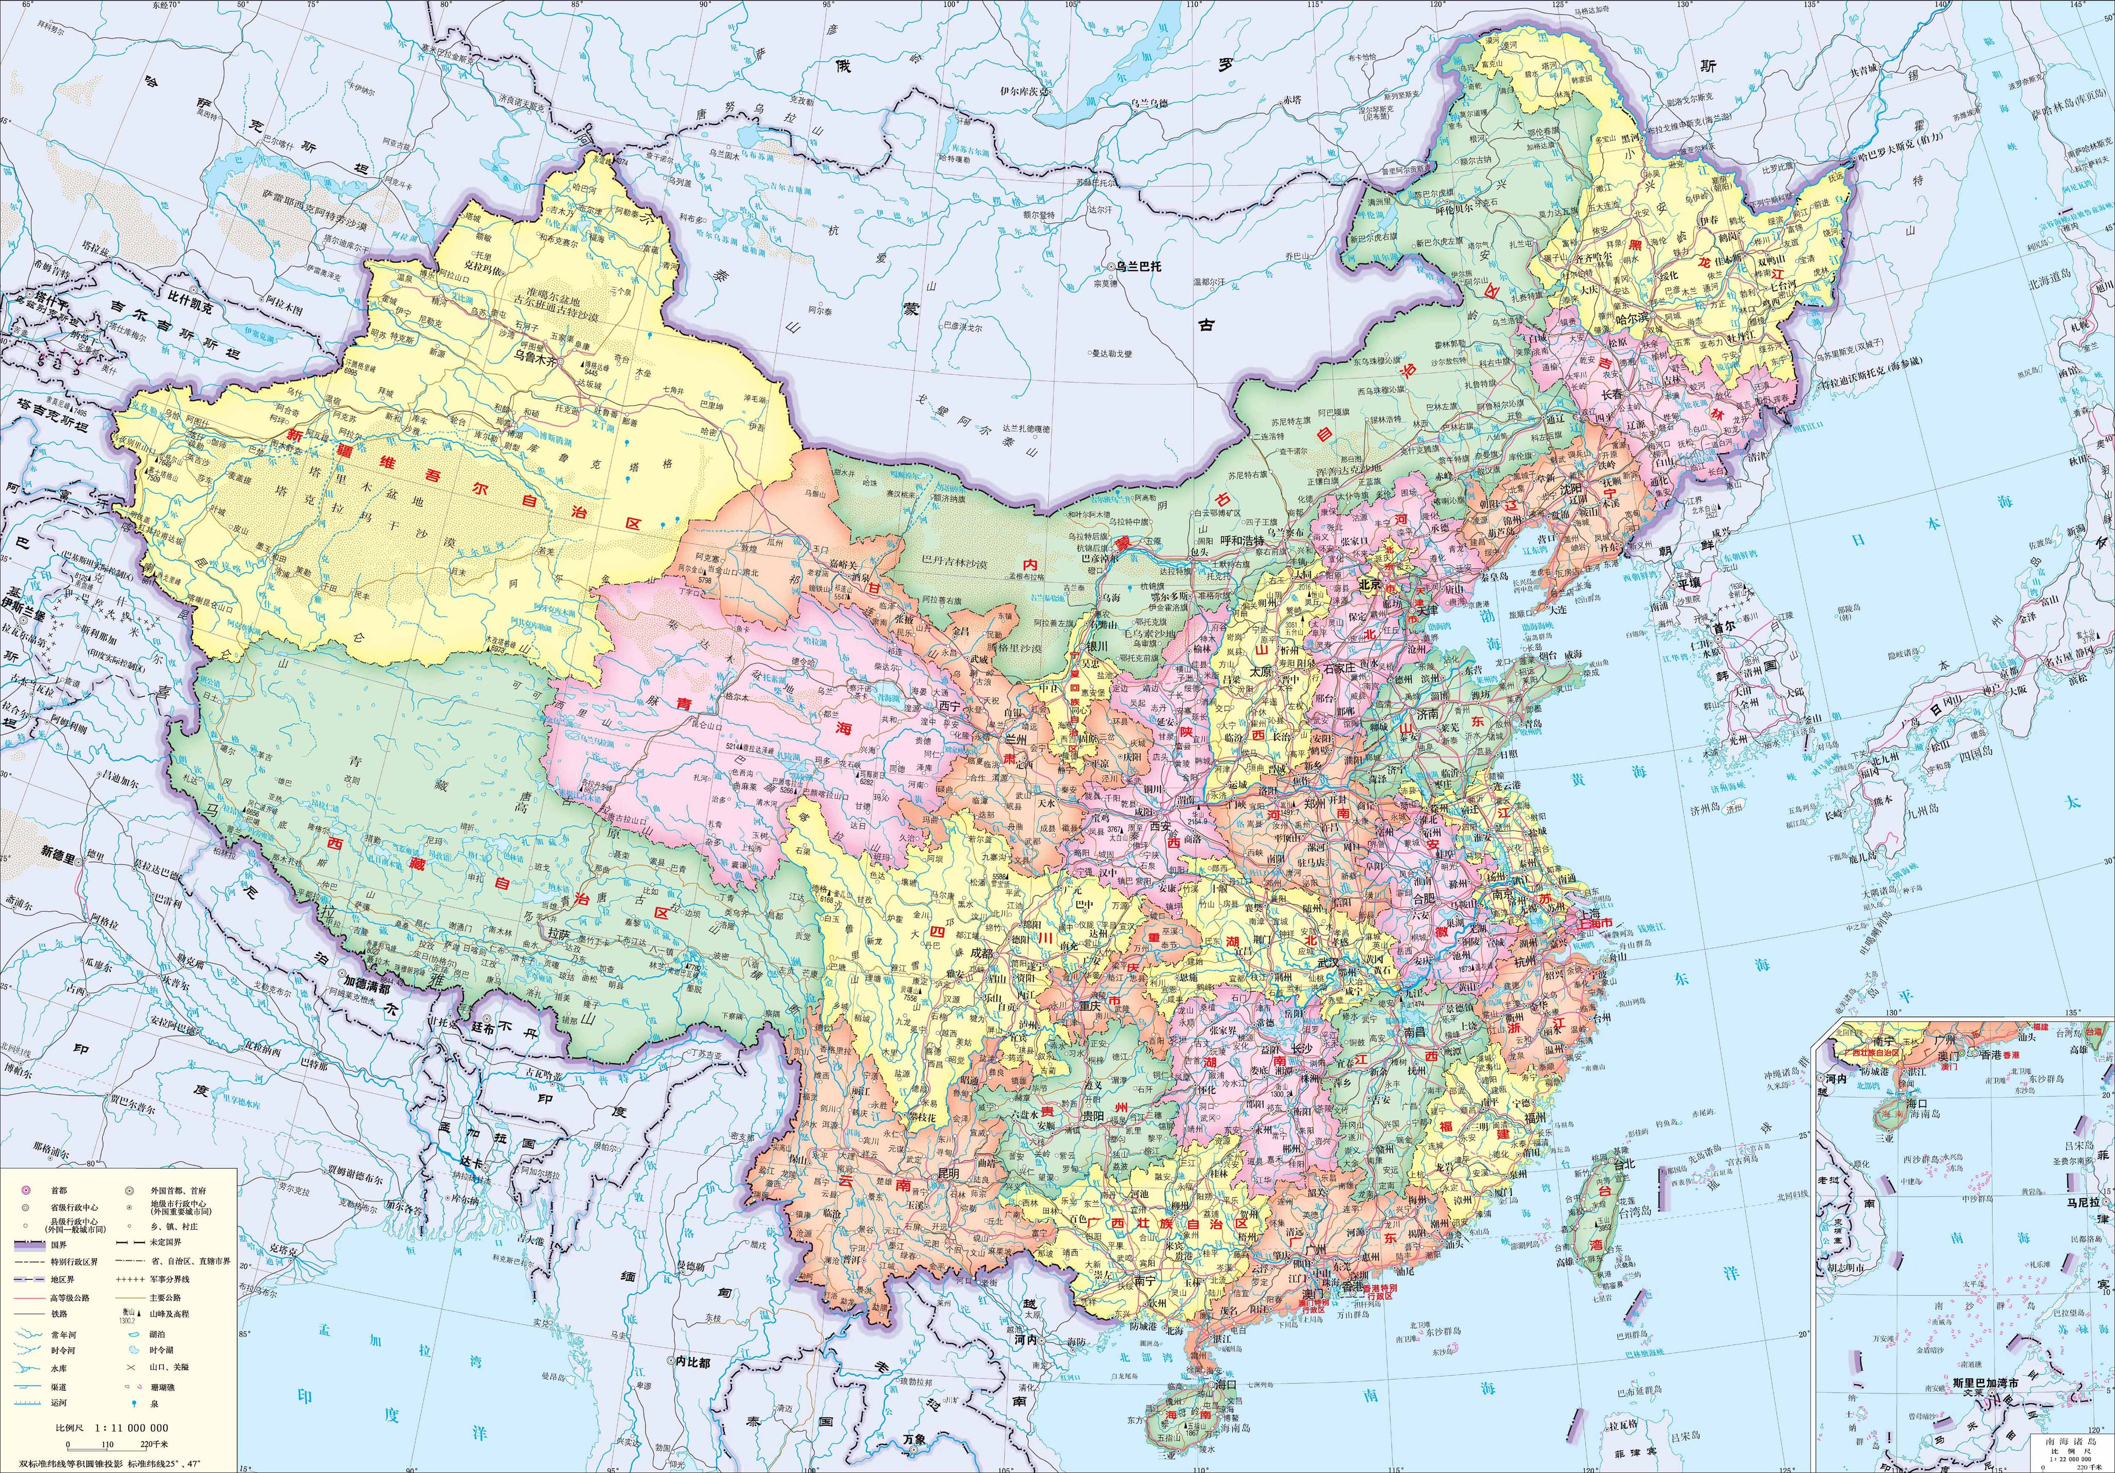
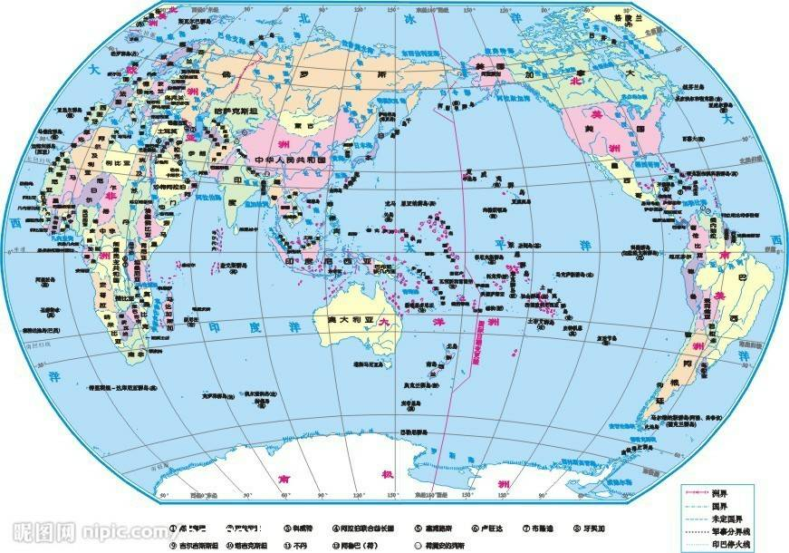
Market
Baidu
Google
Baidu is just for Chinese , so it only has the Chinese market, almost no overseas users. At the same time, it is difficult for you to obtain information overseas
Google is open to the world , and most of people in the world choose google.

Slide 12
Convenience
04

Slide 13

VPN
输入您的标题
OUR COMPANY
Your content to play here, or through paste in this box, and select only the text. Your content to play here
Using Google requires a VPN, and It costs money to get a VPN. But you can use
Baidu directly without VPN.
In addition ,Google's servers are overseas, so access may be a little slower, but I don't mind.

Slide 14
Summarize
Regardless of convenience, Google is better than Baidu in every aspect.
Fifteen years ago, in the United States and China, two search engine companies started almost simultaneously, and fifteen years later, one was studying the feasibility of a quantum computer, and the other was studying how to help people sell counterfeit drugs

Slide 15
Thanks for Listening
thezmmm Time：2022.05

